Slide 1
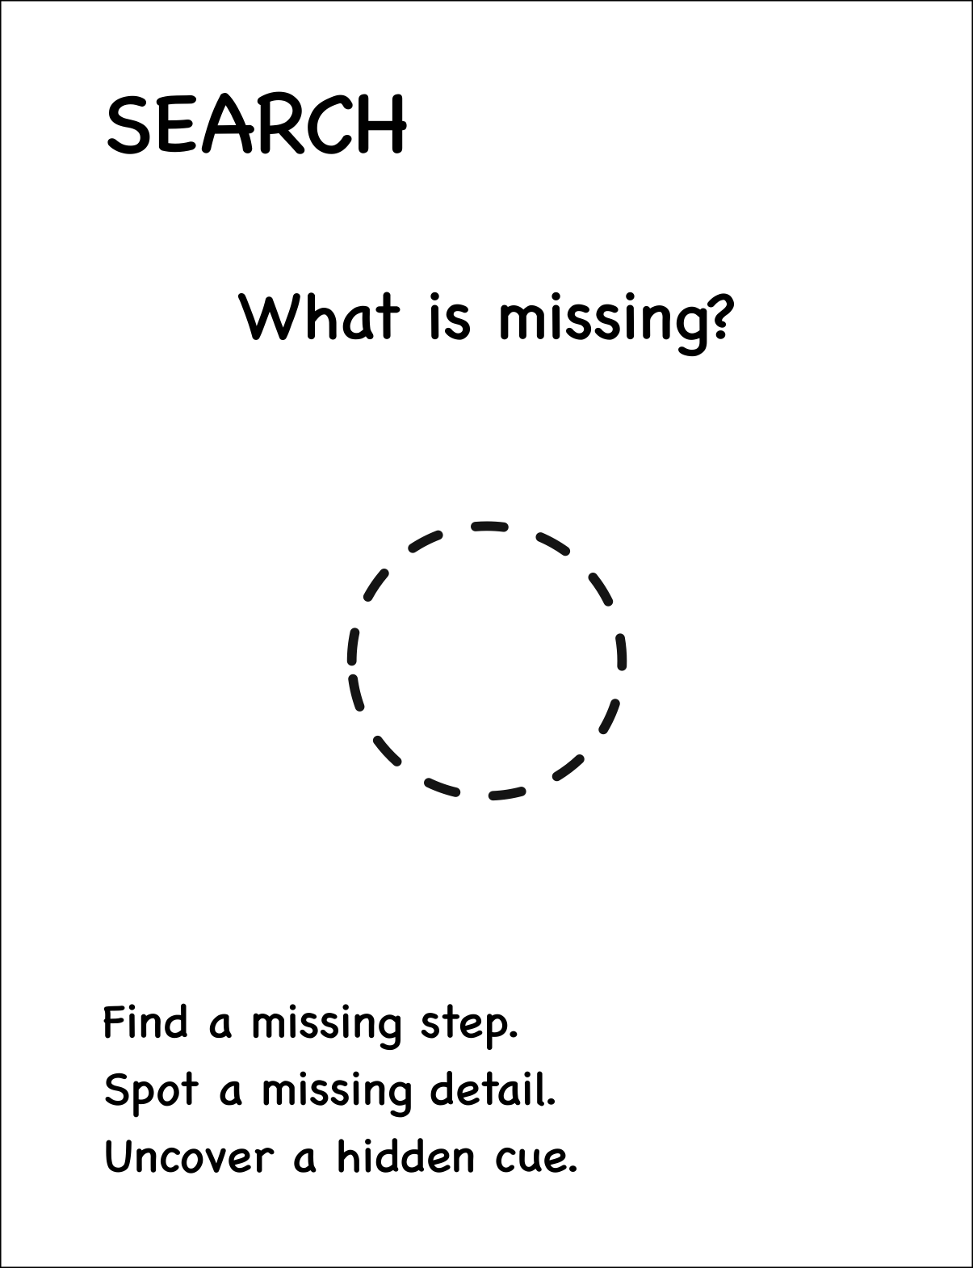
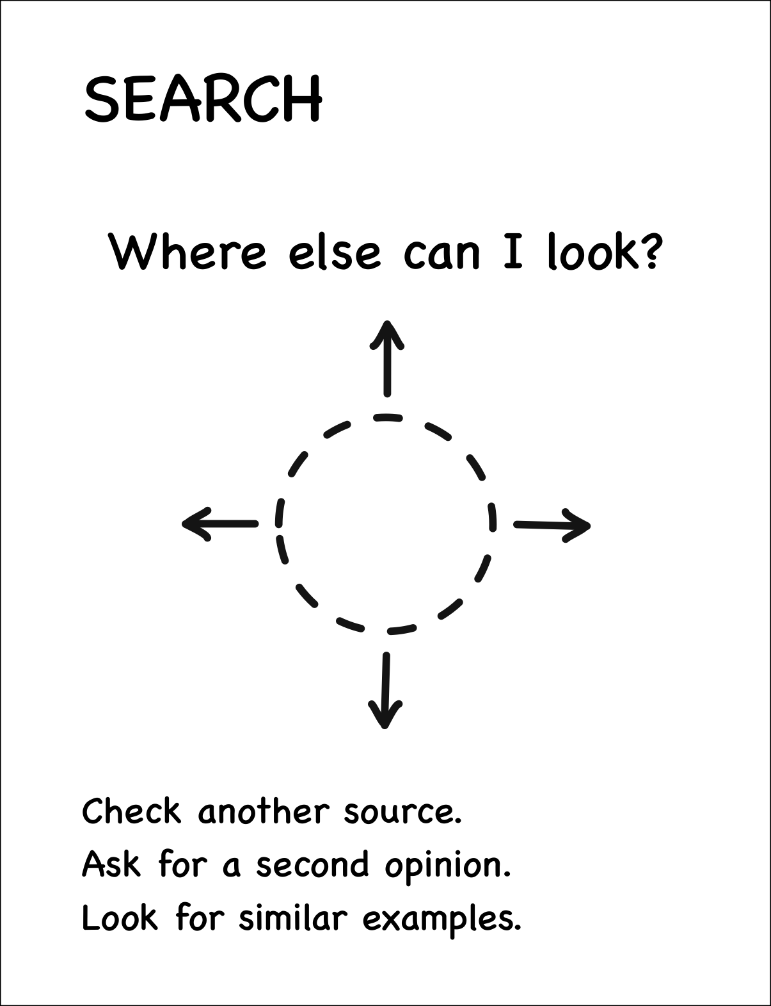
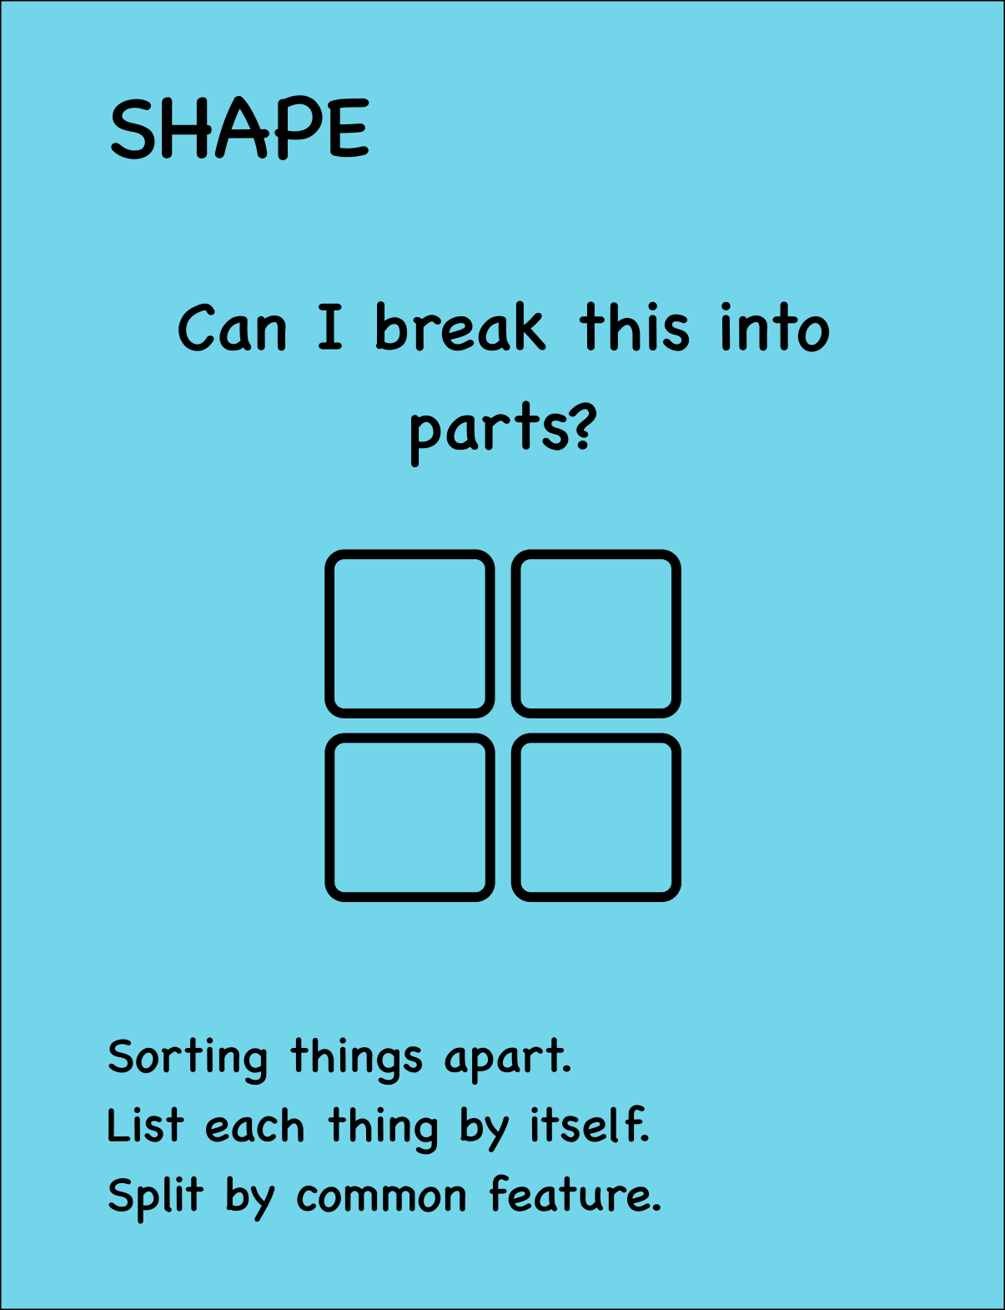
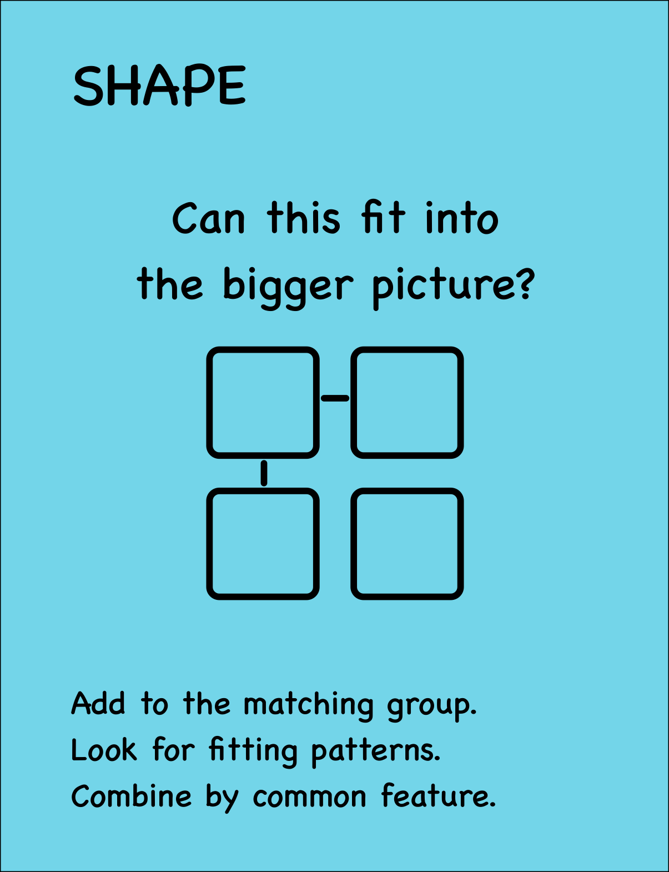
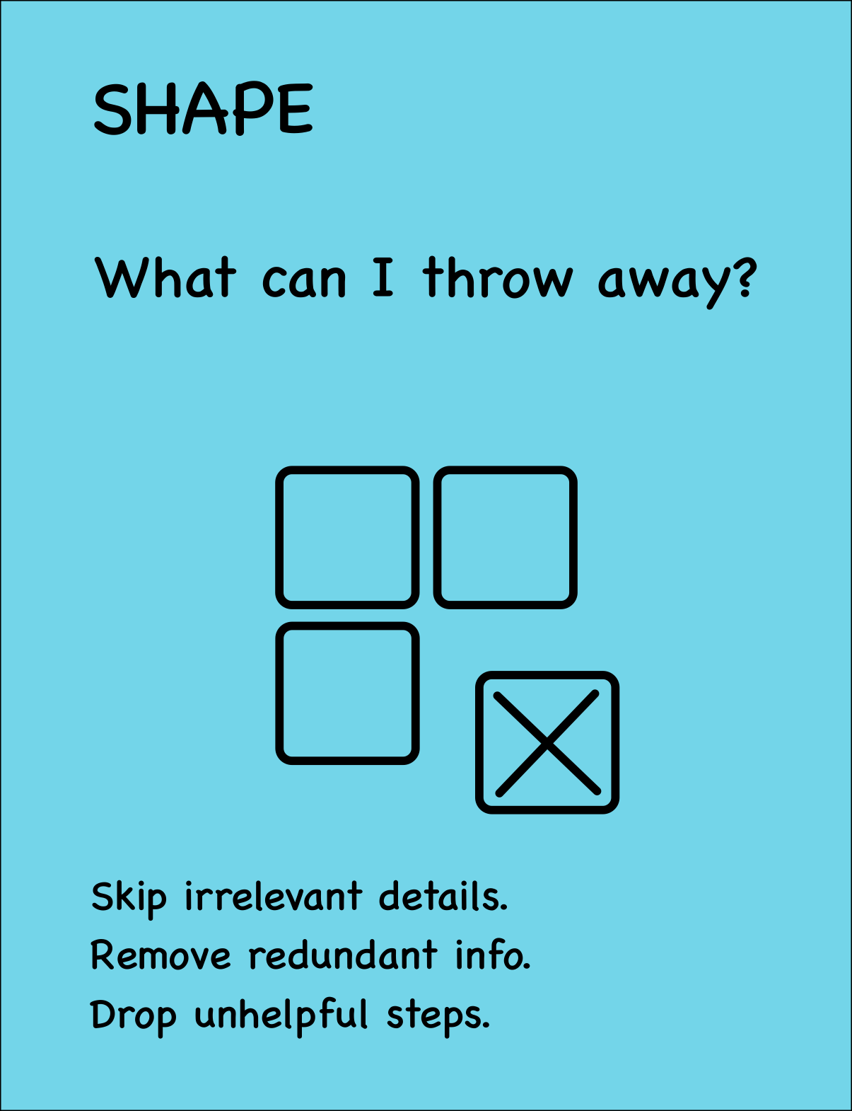

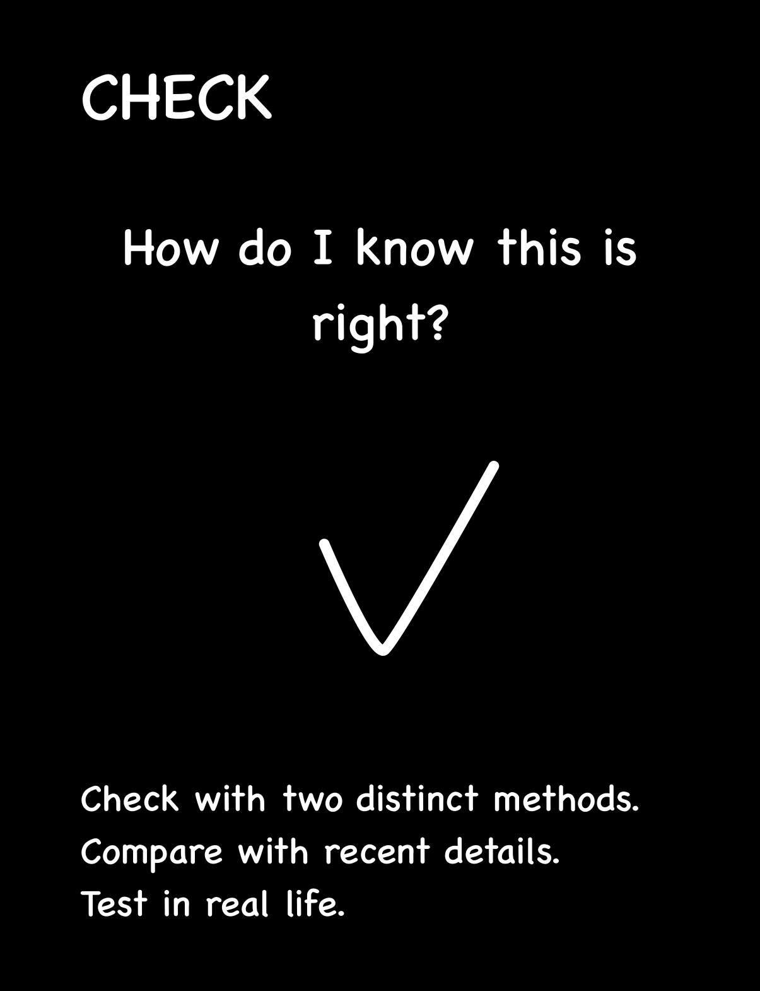
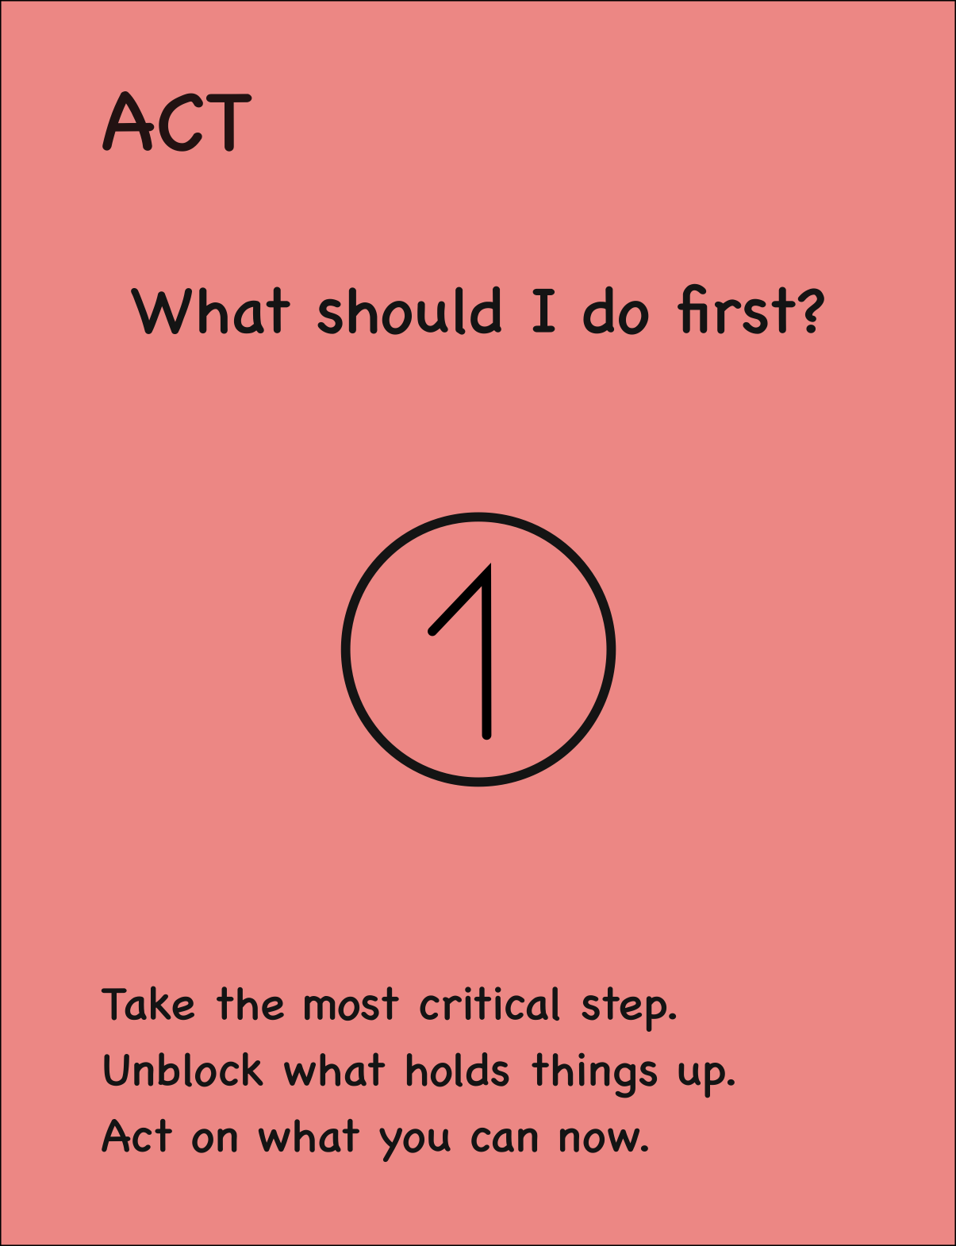
Print the sheet on A4 paper at actual size. Cut around the outer border, then fold along the dashed lines to show the question pair you want to use. Refold the card as the discussion moves to a different pair.
Card 1
Card 2
Card 3
Card 4
Card 5
Card 6
Card 7
Card 8

